Slide 1
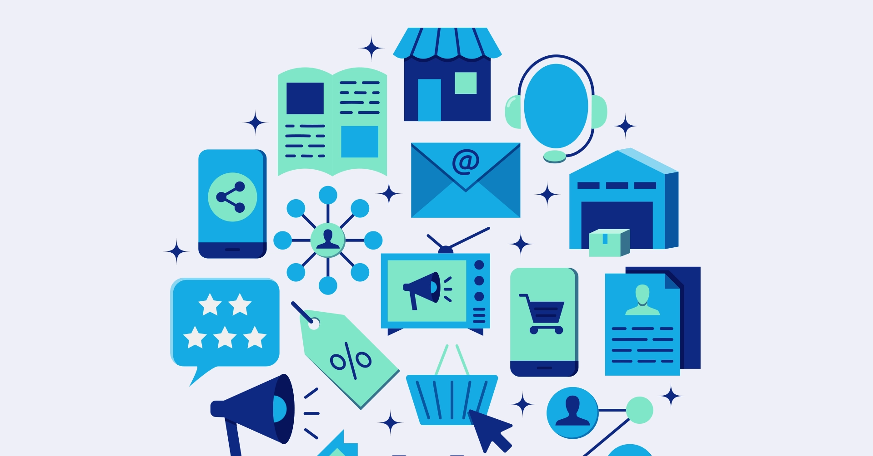
Omni Channel Marketing
maxgrowth
By Prof.Vishal Chugh

Slide 2
What is Omni Channel ?
It helps businesses understand which marketing channels influenced the customer journey and how much each contributed

Slide 3
Process
Assign Credit
Handling Budgets
Channel Performance
A method to assign Credit for conversions across multiple marketing touchpoints
Enables smarter budget allocation and growth decisions
It becomes easy to understand which channel influence conversion and revenue

Slide 4
Proper Attribution Models
First Touch
Last Touch
All credit goes to the first interaction
All credit goes to the final interaction before conversion

Slide 5
Popular Attribution Models
Linear
Time Decay
It gives equal credit to all touchpoints
More credit to recent interactions

Slide 6
When to recommend first touch attribution ?
It is ideal for campaigns focused on brand awareness and initial customer engagement. It helps understand which marketing efforts are most effective at attracting new customers and getting them into the sales funnel.

Slide 7
When to recommend
last touch attribution ?
Suitable when the final interaction before a conversion is crucial, and the sales cycle is relatively short. It helps pinpoint the marketing efforts that directly lead to sales or conversions.

Slide 8
When to recommend
Linear attribution ?
Appropriate when all touchpoints in the customer journey are considered equally important. It provides a balanced view of marketing performance across all interactions.

Slide 9
When to recommend
Time Decay attribution ?
Best for longer sales cycles where recent interactions are likely to have a greater impact on the final decision. It emphasizes the importance of recent touchpoints in the conversion process.

Slide 10



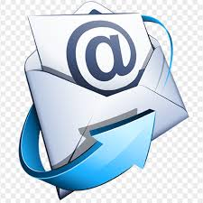
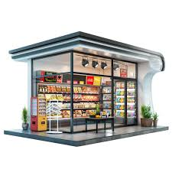
Complete Process to Tap Customers Touchpoints
Common Parameters
Email ID
Phone Number
Loyalty Card
Discounted Coupons
Premium Memberships

Slide 11
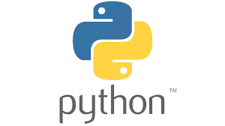
Concepts of Lists, Tuples and Dictionary
maxgrowth
By Prof.Vishal Chugh

Slide 12
What is List ?
In Python, a list is an collection of items (elements) that can store multiple values in a single variable.
Lists are mutable (you can change, add, or remove elements).
Lists can contain different data types (numbers, strings, floats, even other lists).
They are written with square brackets [ ].

Slide 13
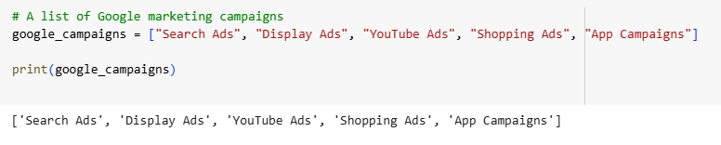
Marketing Campaigns List

Slide 14
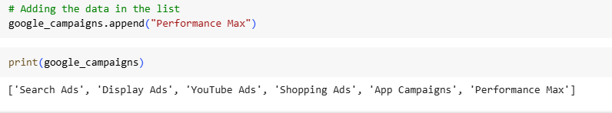
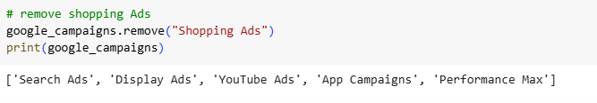
Why are lists useful in Marketing ?

Slide 15
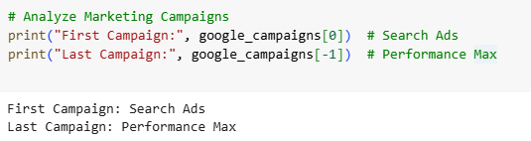
Why are lists useful in Marketing ?

Slide 16
What is Tuple?
A tuple in Python is an collection of items like a list, but it is immutable – meaning once you create it, you cannot change, add, or remove elements.
Written with parentheses ().
Good for data that should not be modified.

Slide 17
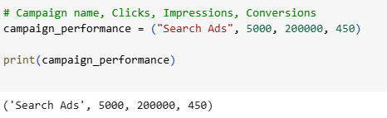
Marketing Campaigns Tuple

Slide 18
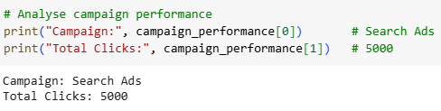
Marketing Campaigns Tuple

Slide 19
What is Dictionary ?
A dictionary in Python is a Semi - Structured data stored in key–value pairs.
Keys act like labels (unique identifiers).
Values are the data associated with those keys.
Written with curly brackets {key1 : value1 , key2: value2 }

Slide 20
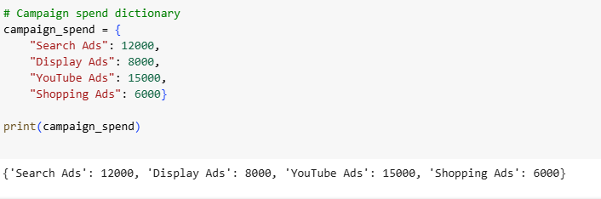
Marketing Campaigns Dictionary

Slide 21
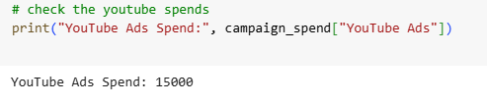
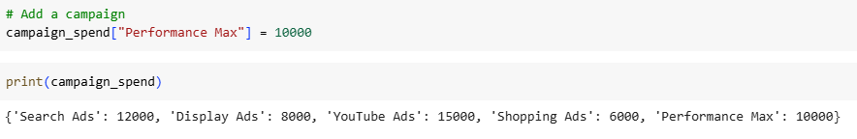
Why Dictionary is useful in Marketing ?

Slide 22
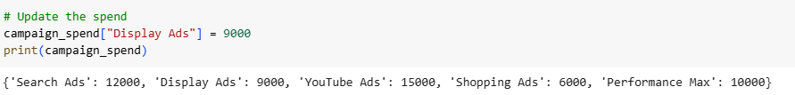
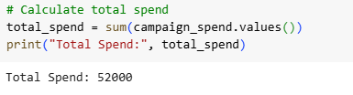
Why Dictionary is useful in Marketing ?

Slide 23
Explore the Data in Python
maxgrowth
By Prof.Vishal Chugh

Slide 24
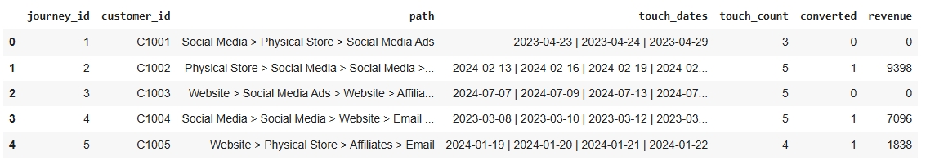
The Omni Channel Data

Slide 25
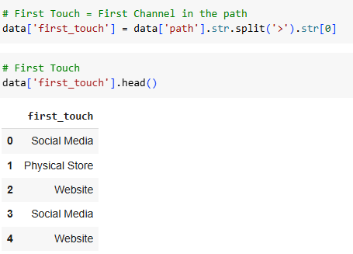
First Touch Attribution

Slide 26
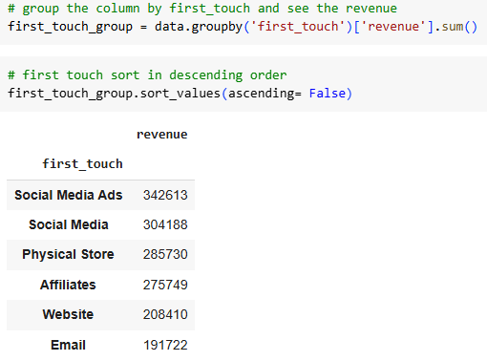
Group the first touch attribution with revenue

Slide 27
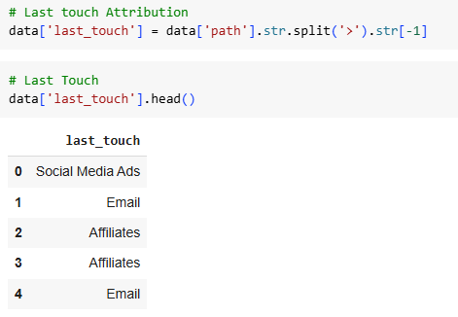
Last Touch Attribution

Slide 28
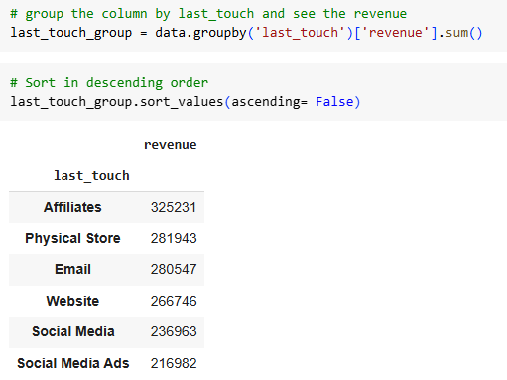
Group the last touch attribution with revenue

Slide 29
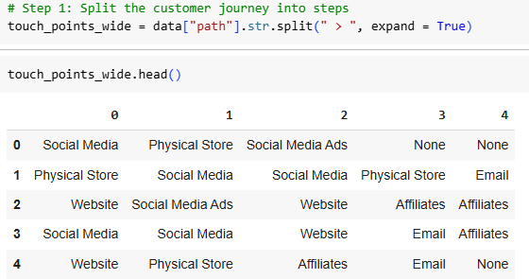
For Linear Attribution We Split the Data

Slide 30
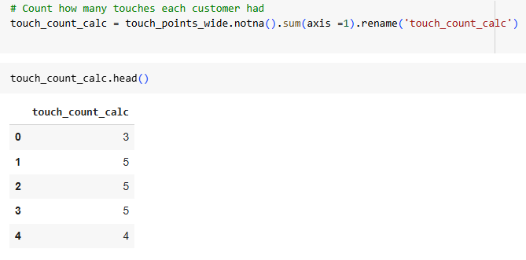
Count touchpoints

Slide 31
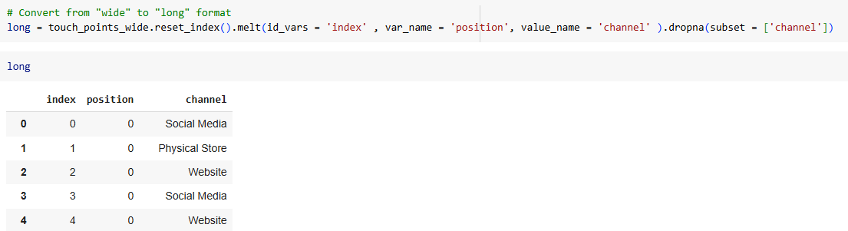
Convert Wide to long format

Slide 32
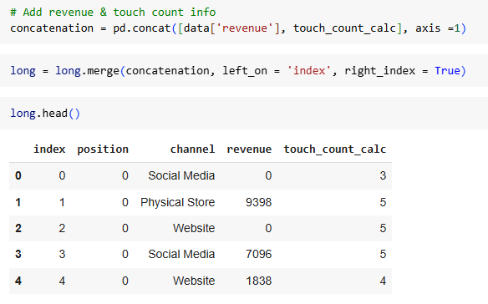
Add Revenue and Touch Point Info

Slide 33
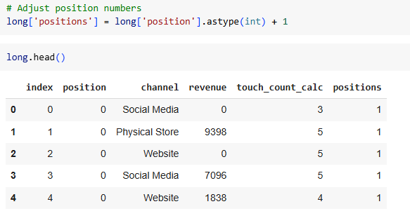
Adjust Position Numbers instead of 0 to 1

Slide 34
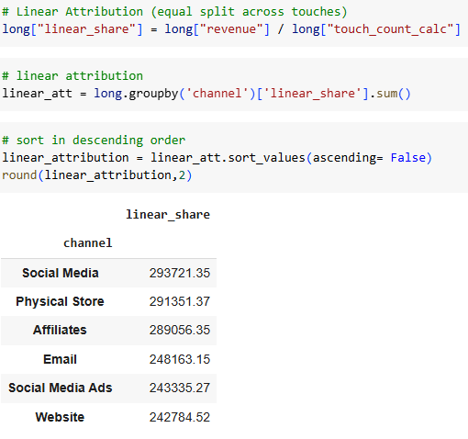
Linear Attribution

Slide 35
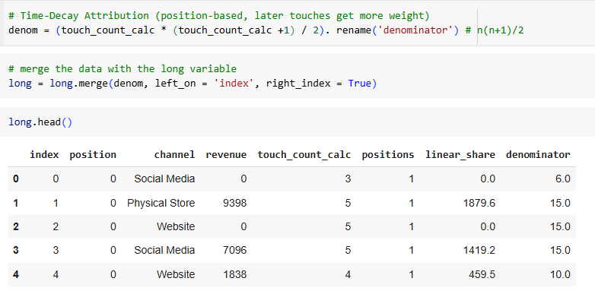
Time Decay Attribution -> n(n+1)/2

Slide 36
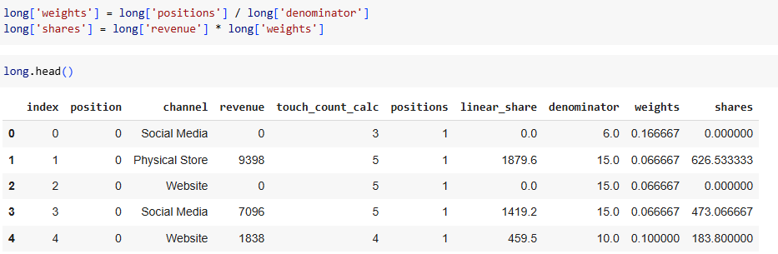
Calculate Weights and Shares

Slide 37
Calculate Weights and Shares

Slide 38
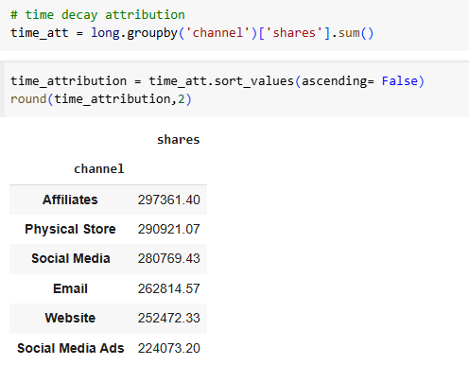
Time Decay Attribution

